Slide 1


Slide 2
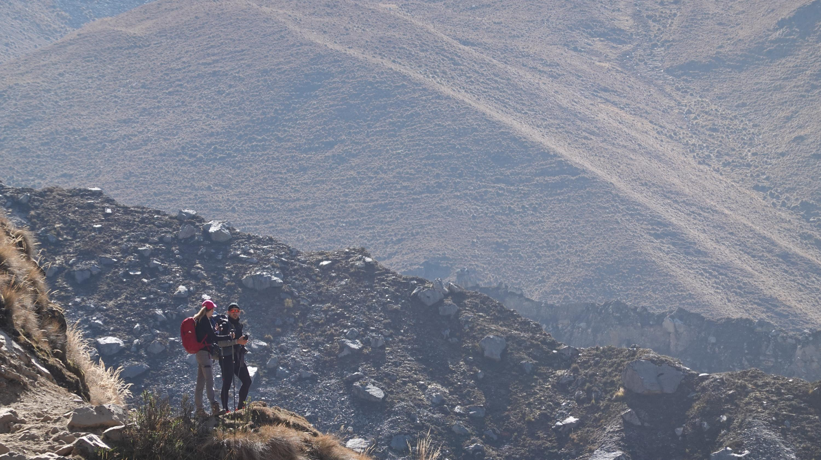
DISPATCH FROM
Salkantay

Slide 3



ANGEL JUAREZ
www.lakwatsero.com
FACEBOOK
TWITTER
INSTAGRAM
@thelakwatsero
@thelakwatsero
@thelakwatsero

Slide 4
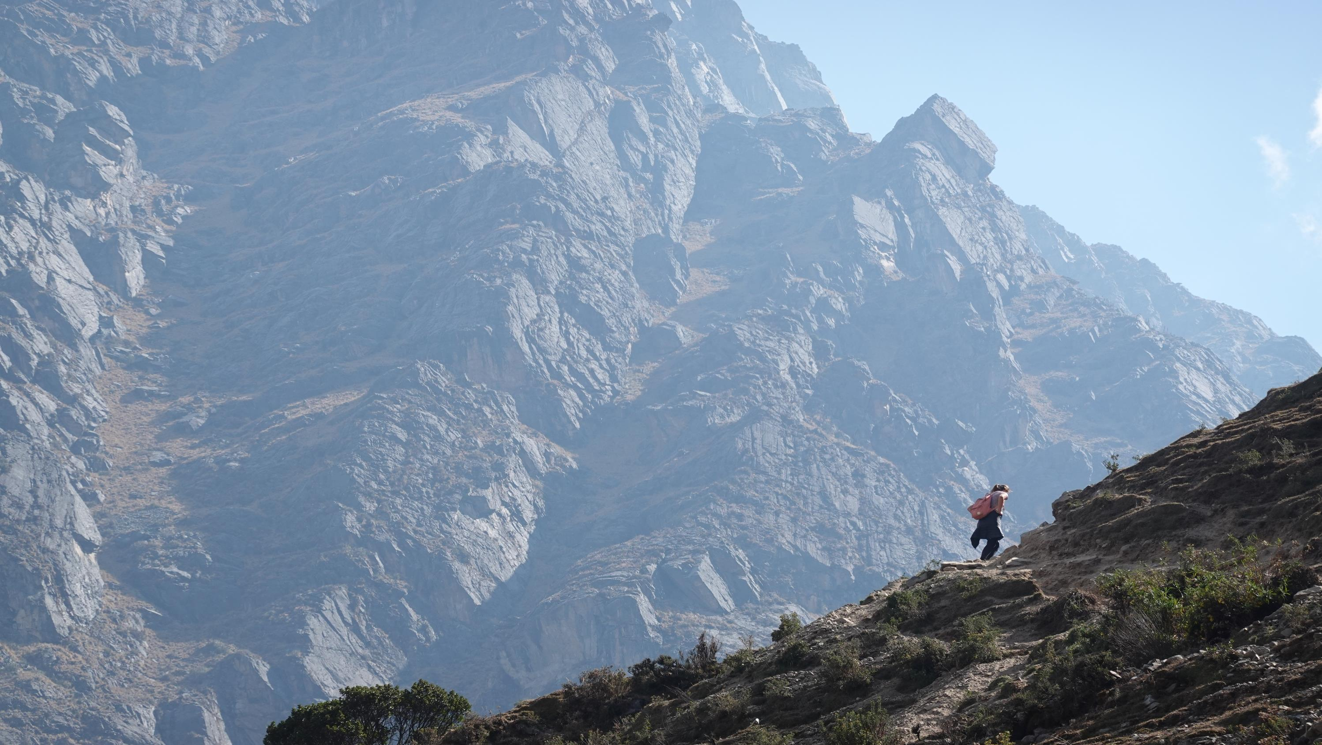
SALKANTAY
TREK
LOCATION: CUSCO, PERU
HIGHEST ELEVATION: 4,620M
MINIMUM DAYS: 5
LENGTH: ~95KM
HIGHLIGHTS: LAKES, ALPINE VIEW, INCA RUINS, MACHU PICCHU

Slide 5
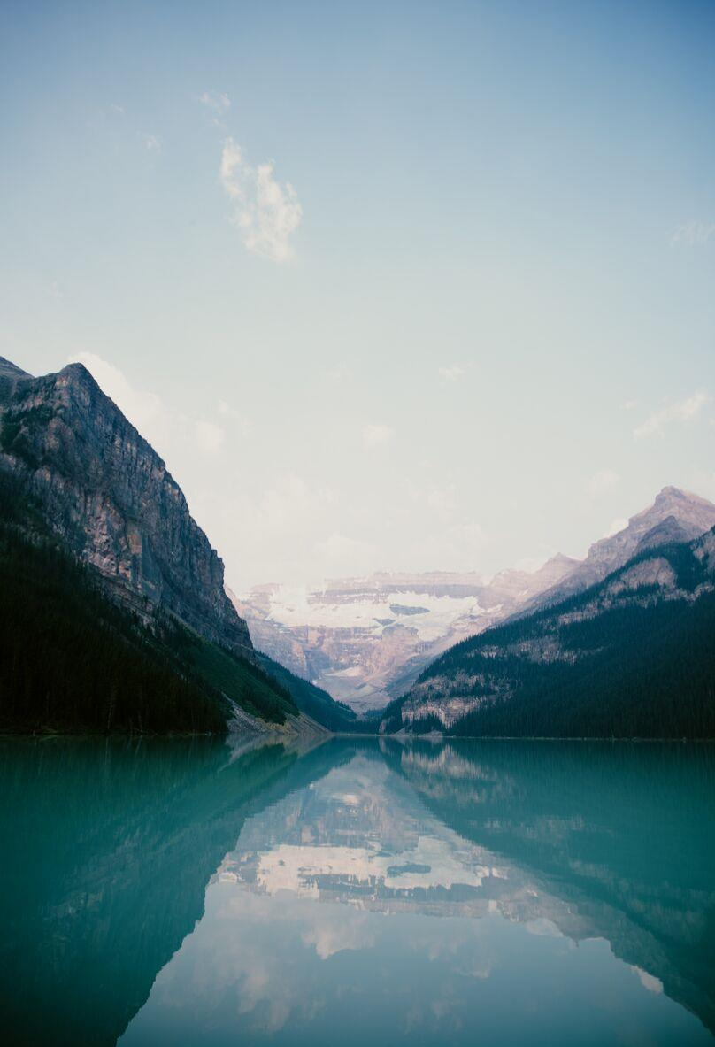
GETTING IN
MANILA TO CUSCO
VIA US
AVERAGE FLYNG HOURS: 32 HOURS
MINIMUM STOPS: 2 (LAX, LIM)
AVERAGE PRICE: $2,450
VIA EUROPE
AVERAGE FLYNG HOURS: 32 HOURS
MINIMUM STOPS: 3 (TPE, AMS, BOG)
AVERAGE PRICE: $2,776

Slide 6
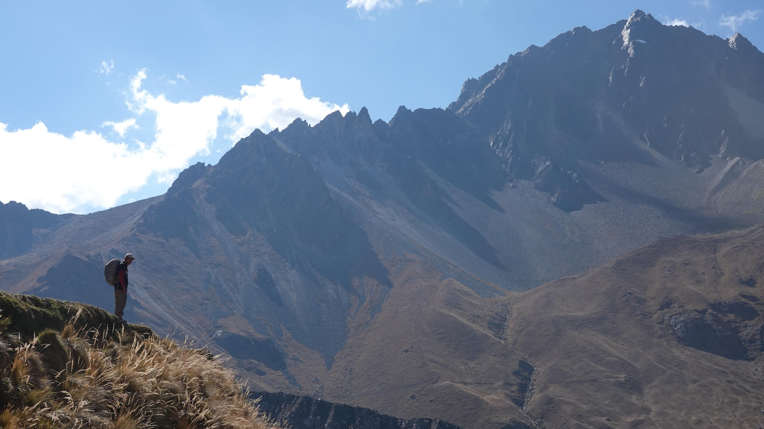
WHY SALKANTAY?
One of the trails going to Machu Picchu
Among the 25 Best Treks in the World*
Less crowded but just as beautiful as Inca Trail
No permit required
Can be done as guided tour or independently
*According to National Geographic Adventure Travel Magazine

Slide 7
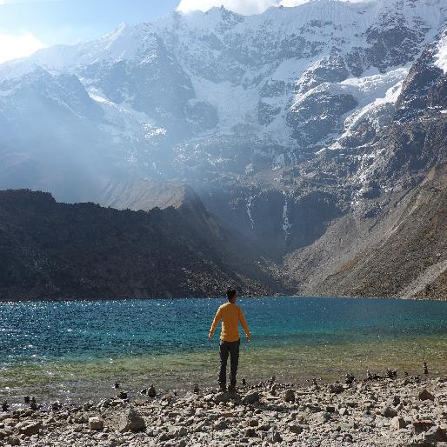
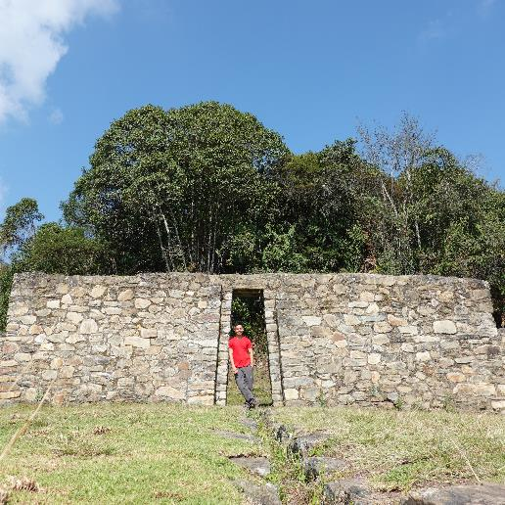
SALKANTAY
INCA
Permit is not required
Guide is not required
Can be done solo
Lodge accommodation
Minimum cost: $140 (self-guided) / $300 (packaged)
Minimum Days: 5
Permit is required
Guide is required
Group tour only
Tent accommodation
Minimum Cost: $500
Minimum Days: 4

Slide 8
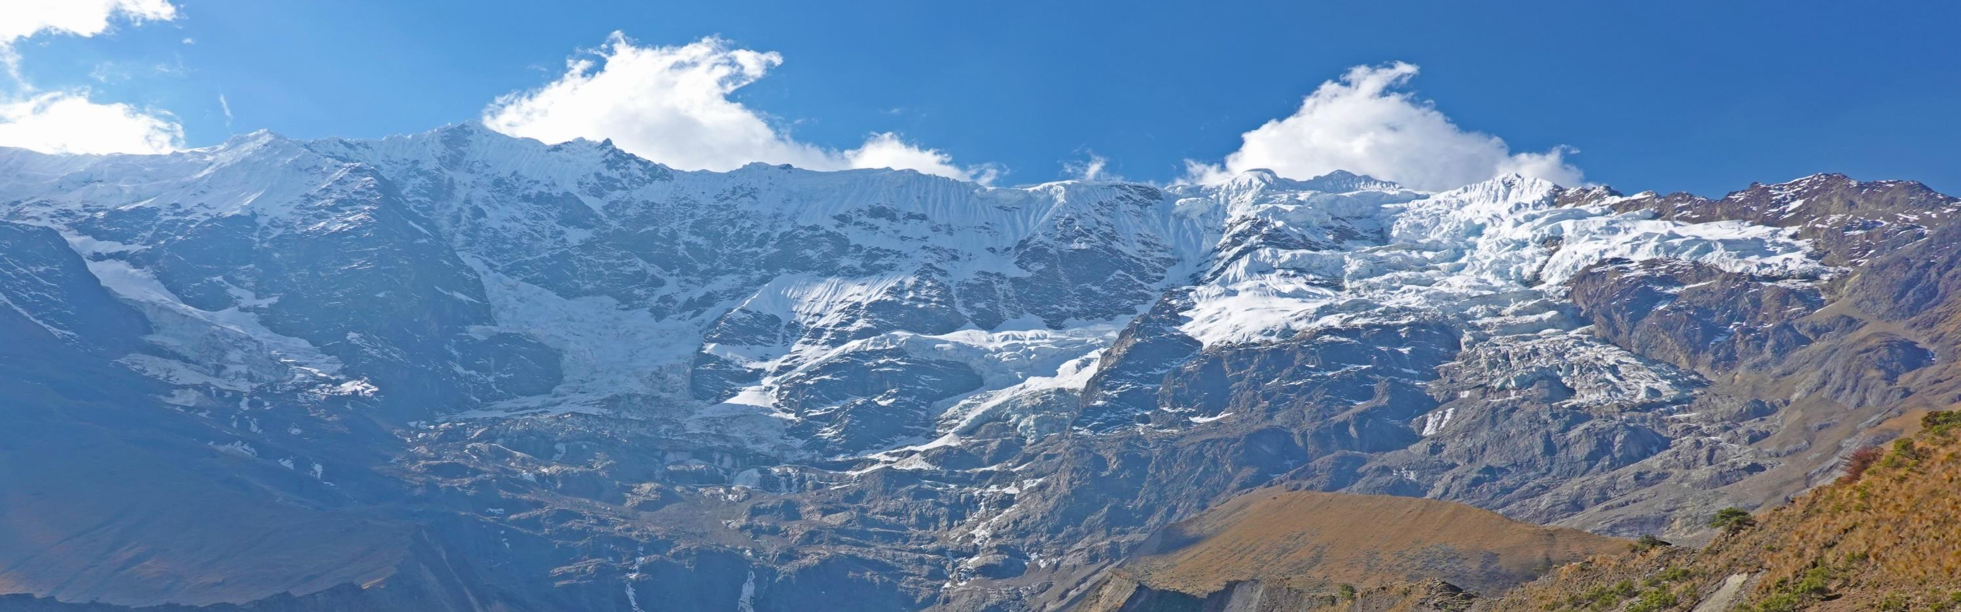
PACKING LIST
GEAR
GADGET
APPS
40L Backpack
Trekking shoes
Bubble jacket
Fleece
Trekking pants
Warmers
Sleeping Bag
Sony RX100VI
Sony RX100V (Back-up)
Sony Xperia XZ1
Action camera
Table pod
Powerbanks
Maps.me (Offline Maps)
Google Translate
Currency Converter
SkyView

Slide 9
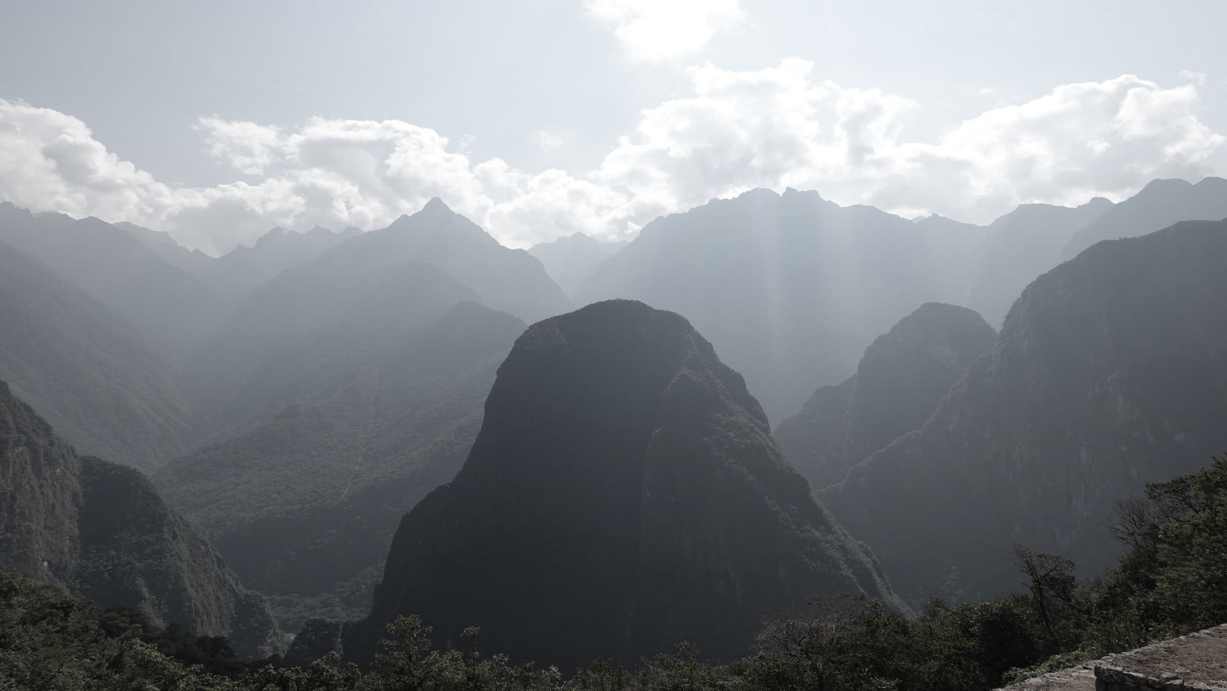
ITINERARY
5D/4N SALKANTAY TREK
DAY 1
DAY 2
DAY 3
DAY 4
DAY 5
Cusco to Molleparata to Soraypampa
(Lake Humantay)
-
5 KM
Soraypampa to Abra Salkantay to Chaullay
(Salkantaykocha)
-
25 KM
Chaullay to Lucmabamba
-
20 KM
Lucmabamba t0 Llactapata to Hidroelectrica to Aguas Calientes
-
21 KM
Aguas Calientes to Machu Picchu to Hidroelectrica to Cusco
-
21 KM

Slide 10
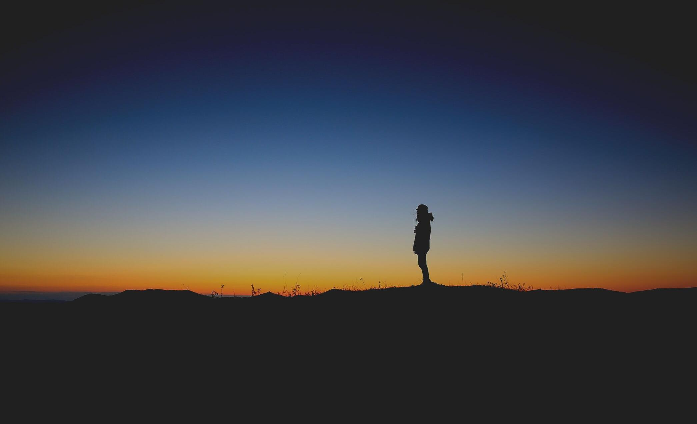

IT STARTS IN CUSCO
Historic capital of Inca Empire from 13th until the 16th century
Designated as UNESCO World Heritage Site in 1983

Slide 11
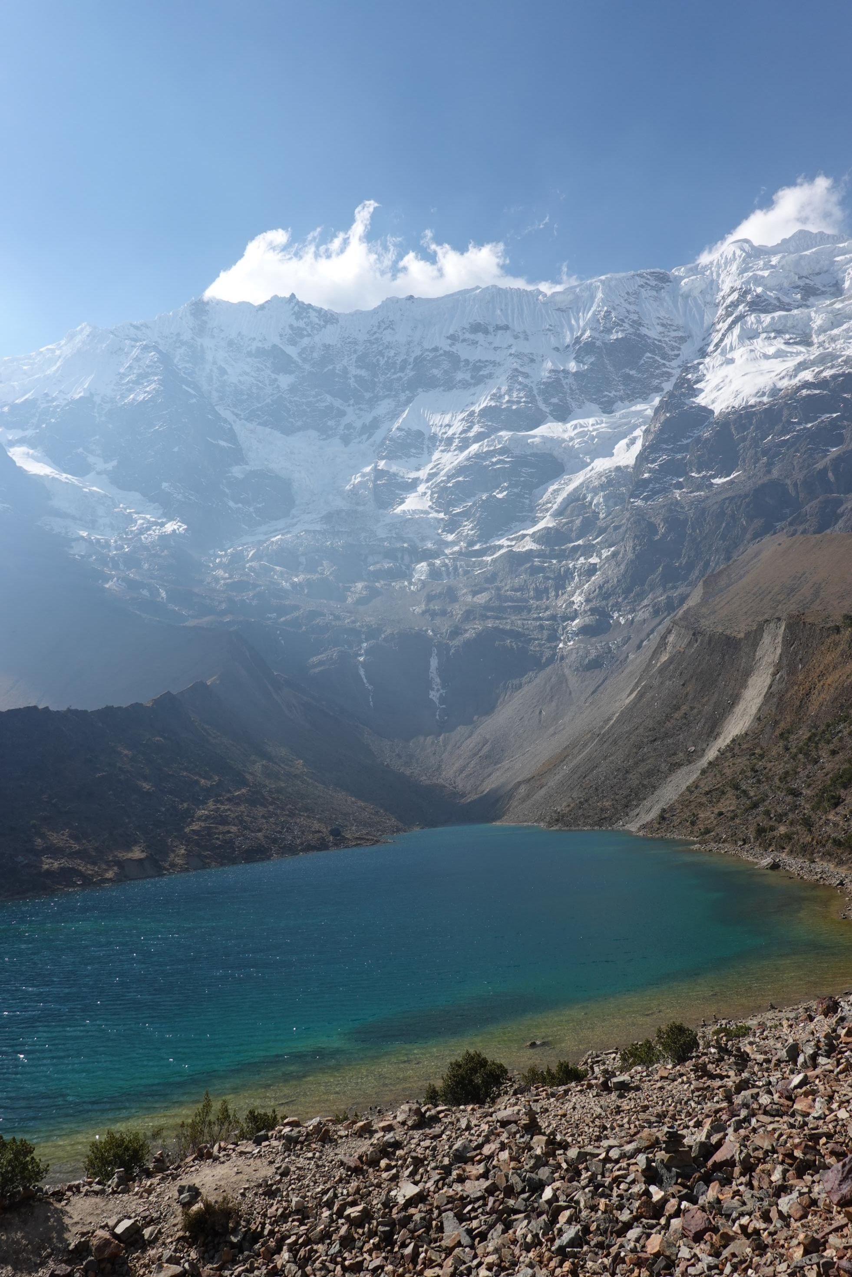
DAY 1:
CUSCO TO SORAYPAMPA
0930H
Depart Cusco
1300H
Arrive in Soraypampa
1445H
Lake Humantay
1600H
Back in Soraypampa

Slide 12
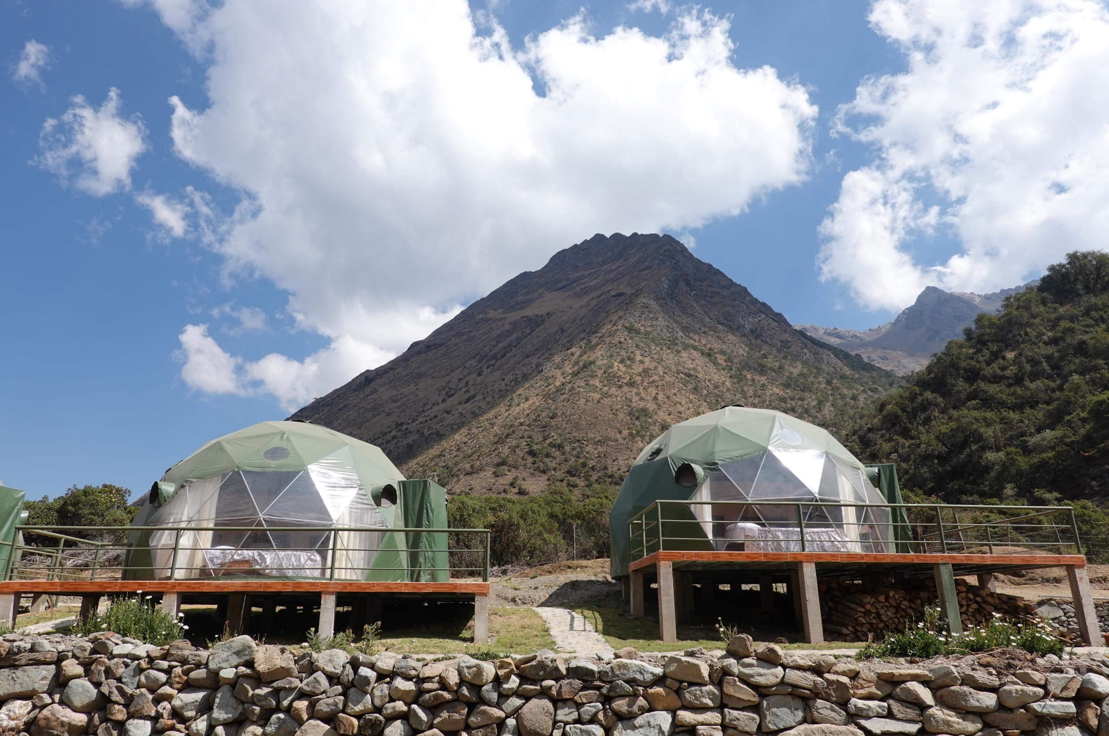
DAY 1: HIGHLIGHTS
SORAYPAMPA

Slide 13
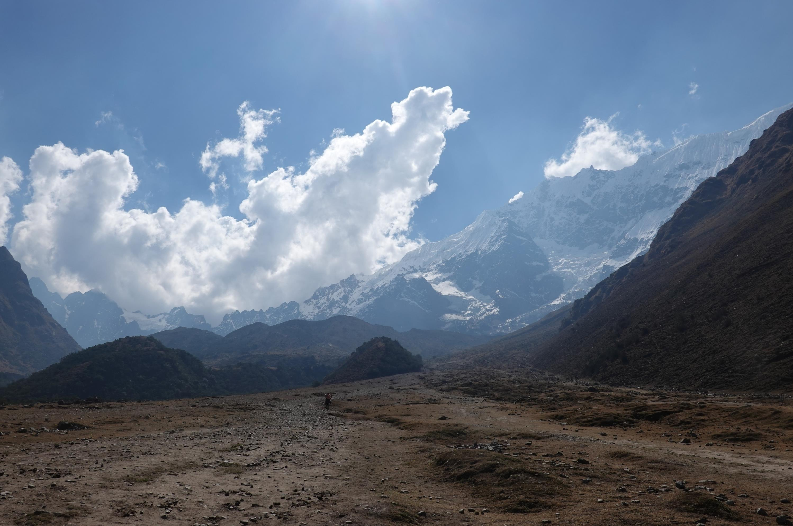
DAY 1: HIGHLIGHTS
5-KM TREK TO LAKE HUMANTAY

Slide 14
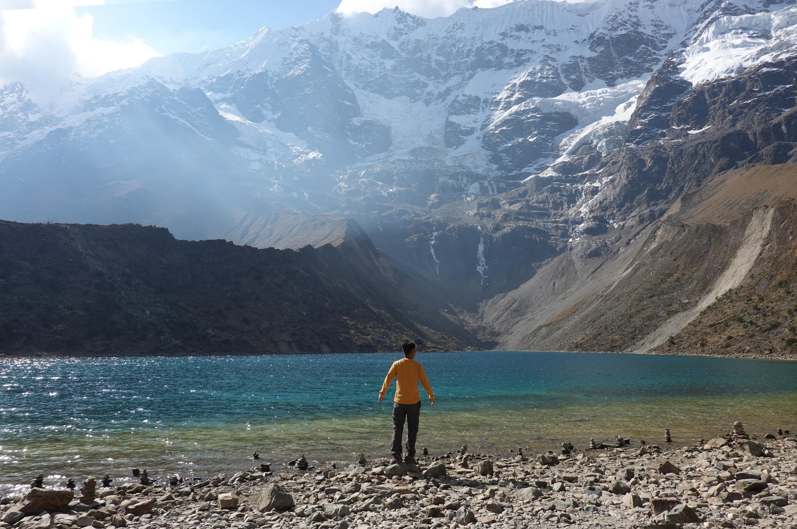
DAY 1: HIGHLIGHTS
LAKE HUMANTAY

Slide 15
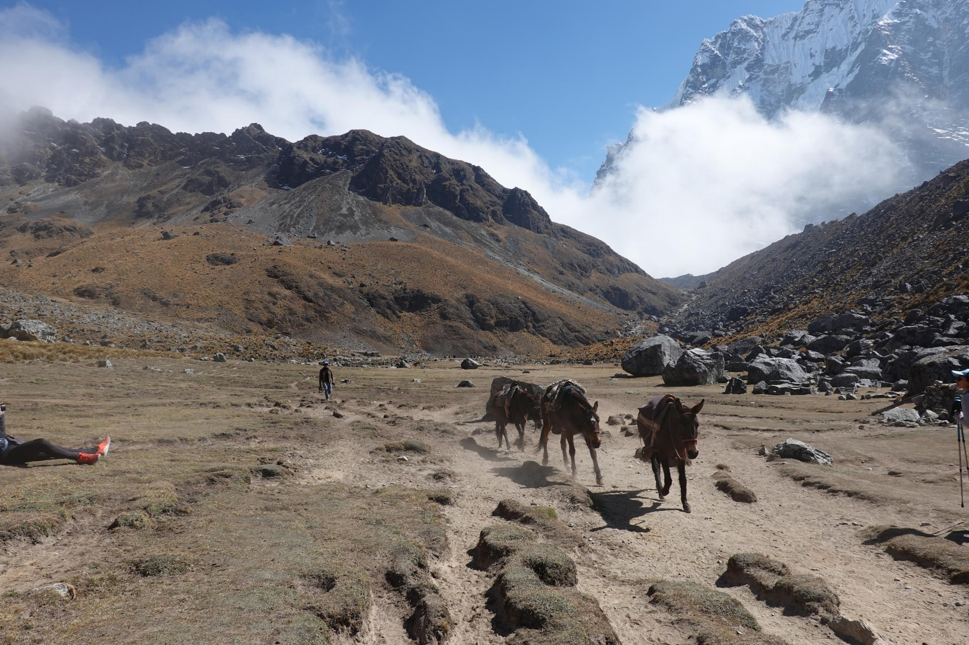
DAY 2:
SORAYPAMPA TO CHAULLAY
0545
Depart Soraypampa
1015H
Abra Salkantay (4,630 MASL)
1045H
Lake Salkantaycocha
1500H
Arrive in Chaullay

Slide 16
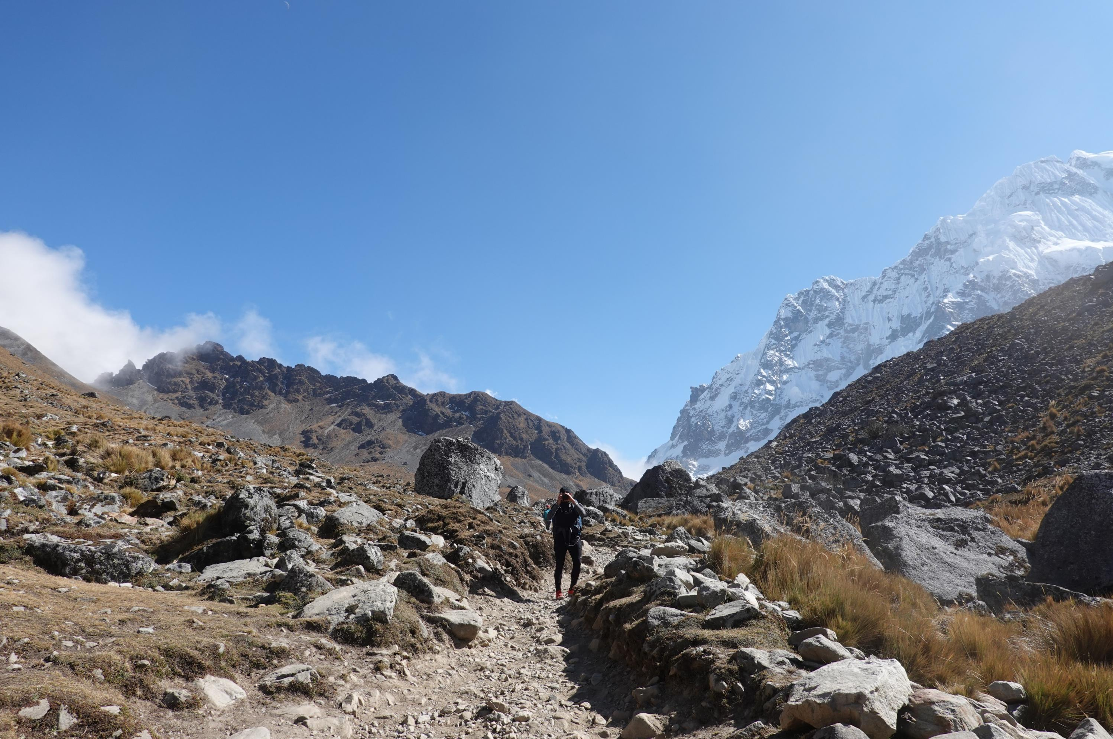
DAY 2: HIGHLIGHTS
8-KM ASSAULT TO SALKANTAY PASS

Slide 17
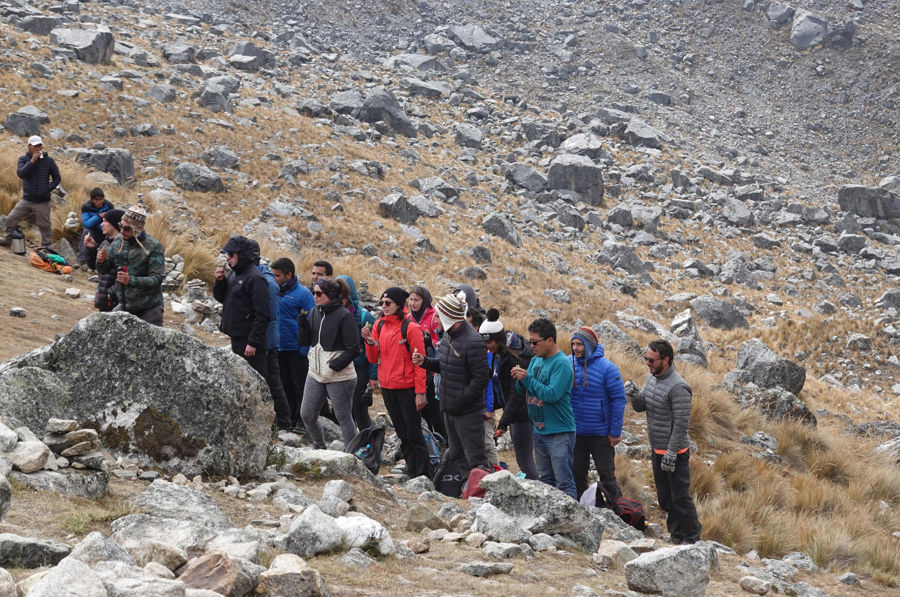
DAY 2: HIGHLIGHTS
ABRA SALKANTAY (4,630 MASL)

Slide 18
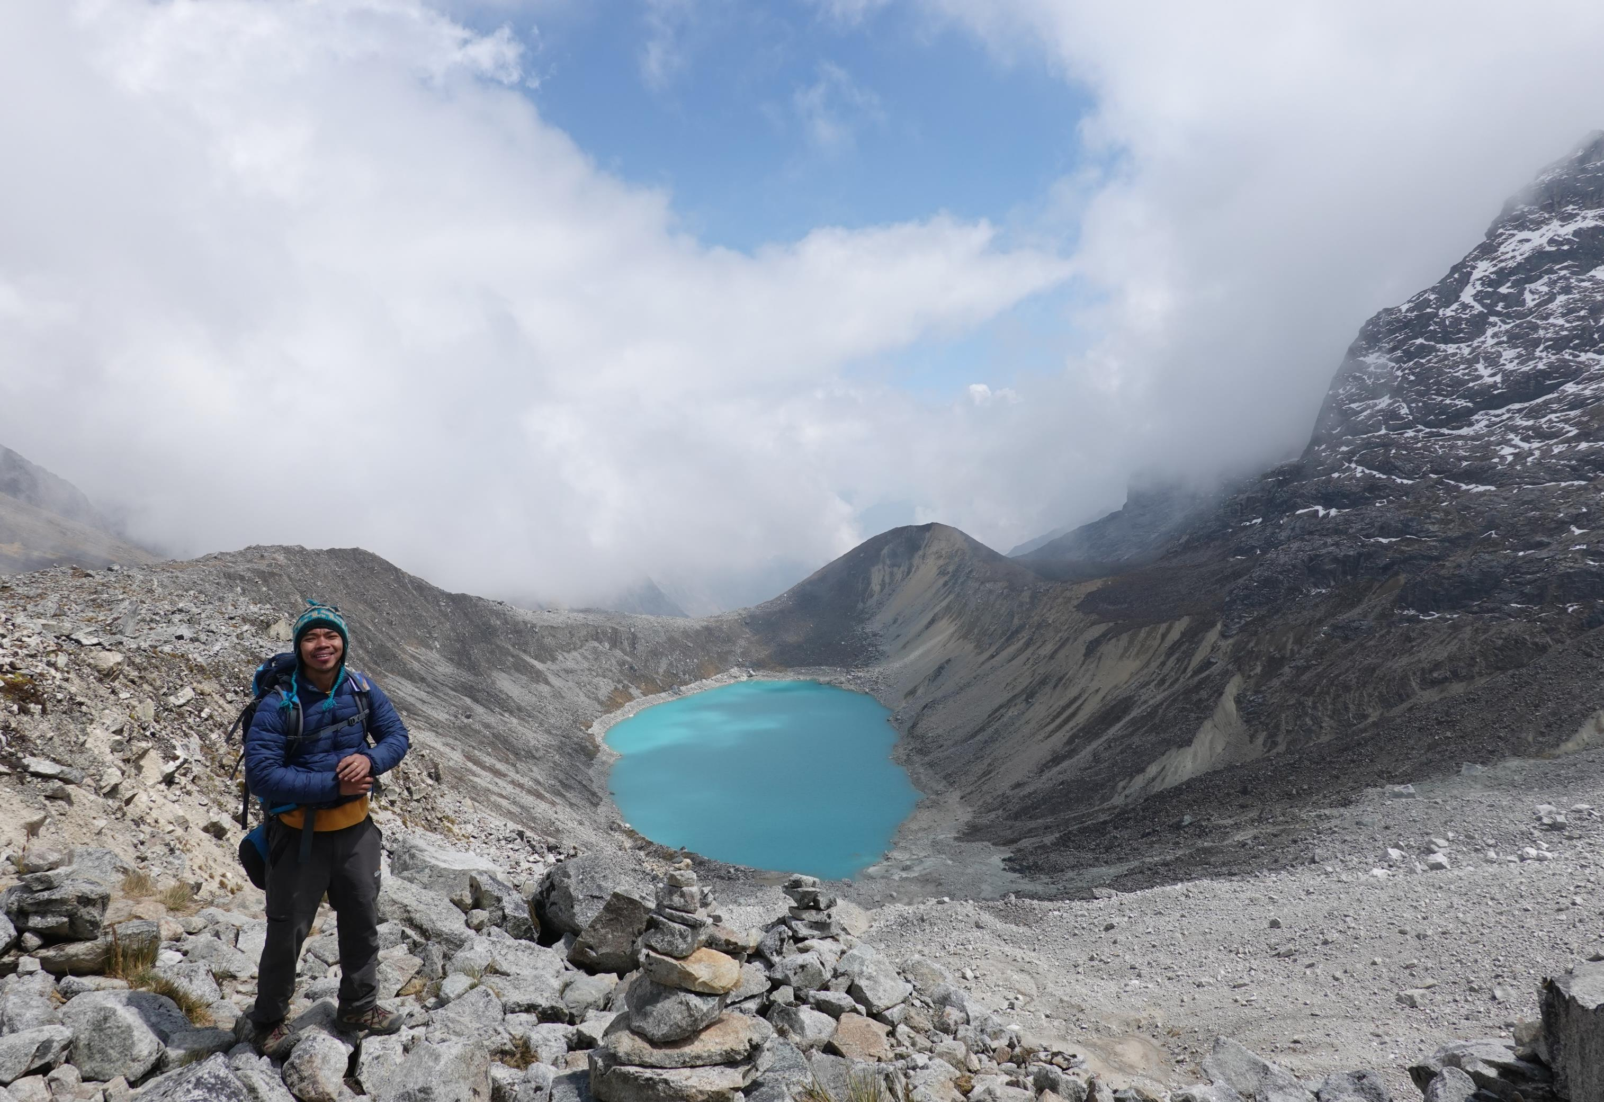
DAY 2: HIGHLIGHTS
LAKE SALKANTAYCOCHA

Slide 19
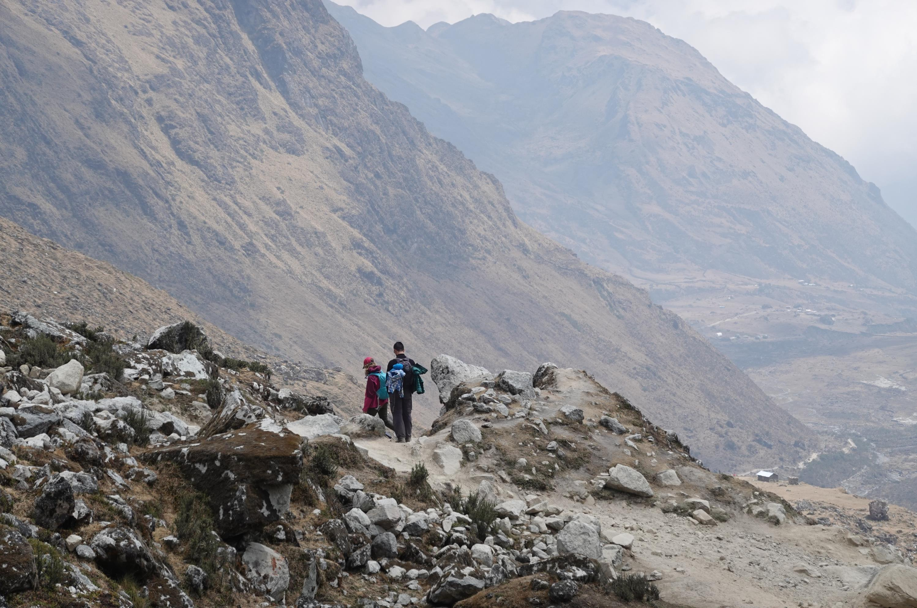
DAY 2: HIGHLIGHTS
16-KM DESCENT TO CHAULLAY

Slide 20
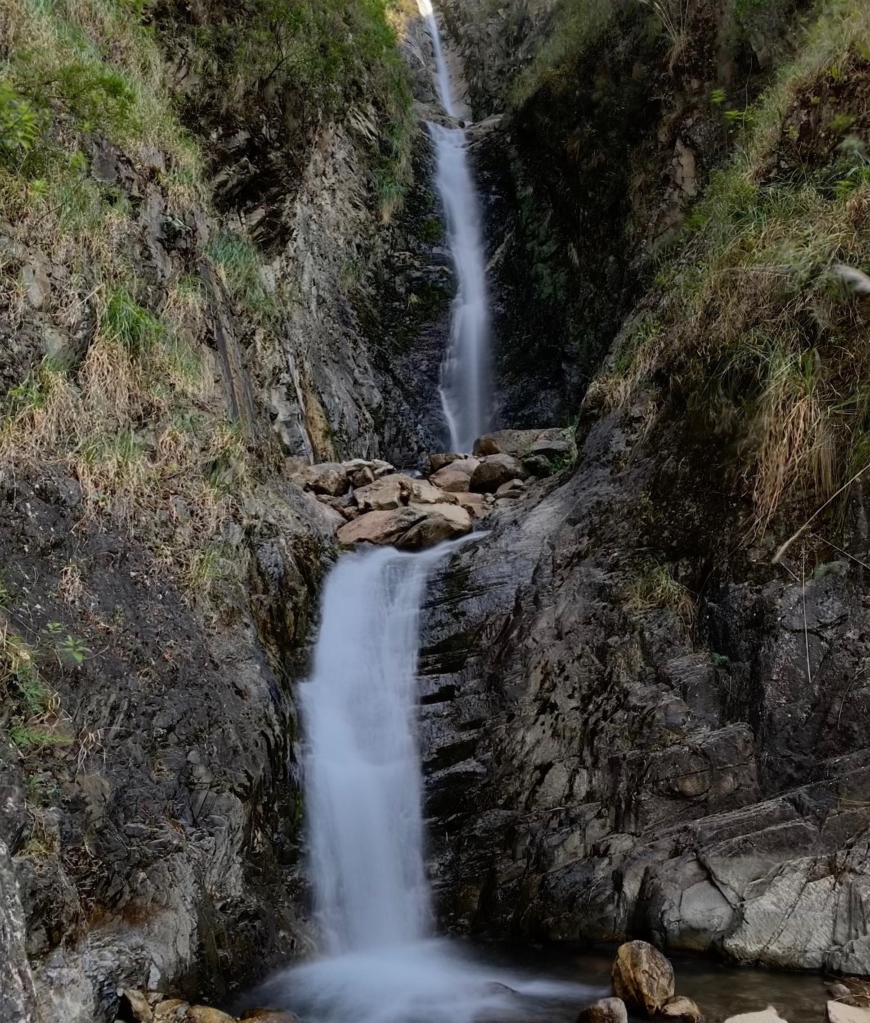
DAY 3:
CHAULLAY TO LUCMABAMBA
0630H
Depart Chaullay
1120H
Arrive in Sahuayaco, Sta. Teresa
1300H
Arrive in Lucmabamba

Slide 21
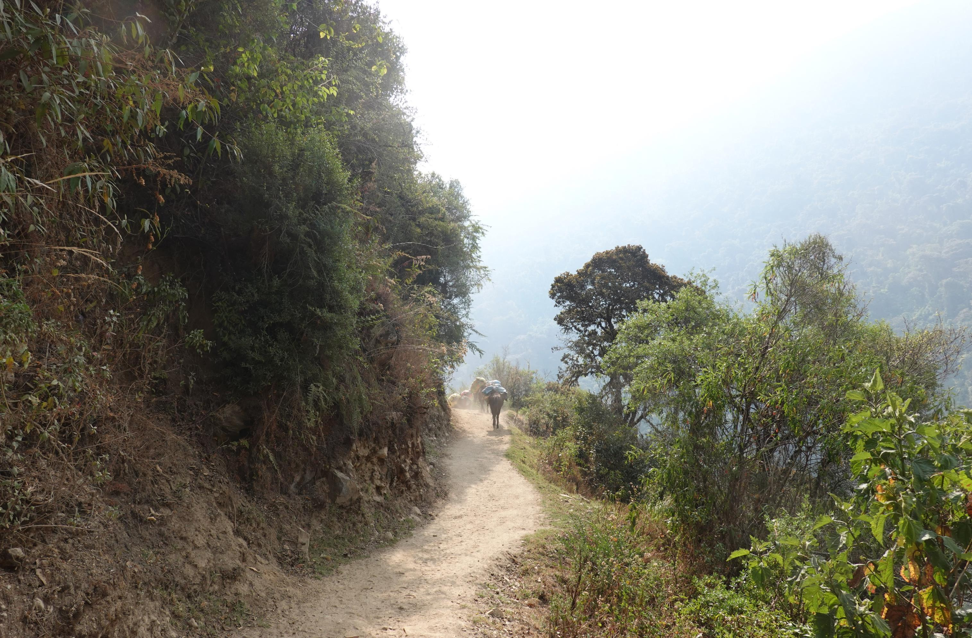
DAY 3: HIGHLIGHTS
18-KM OF ROLLING TRAIL

Slide 22
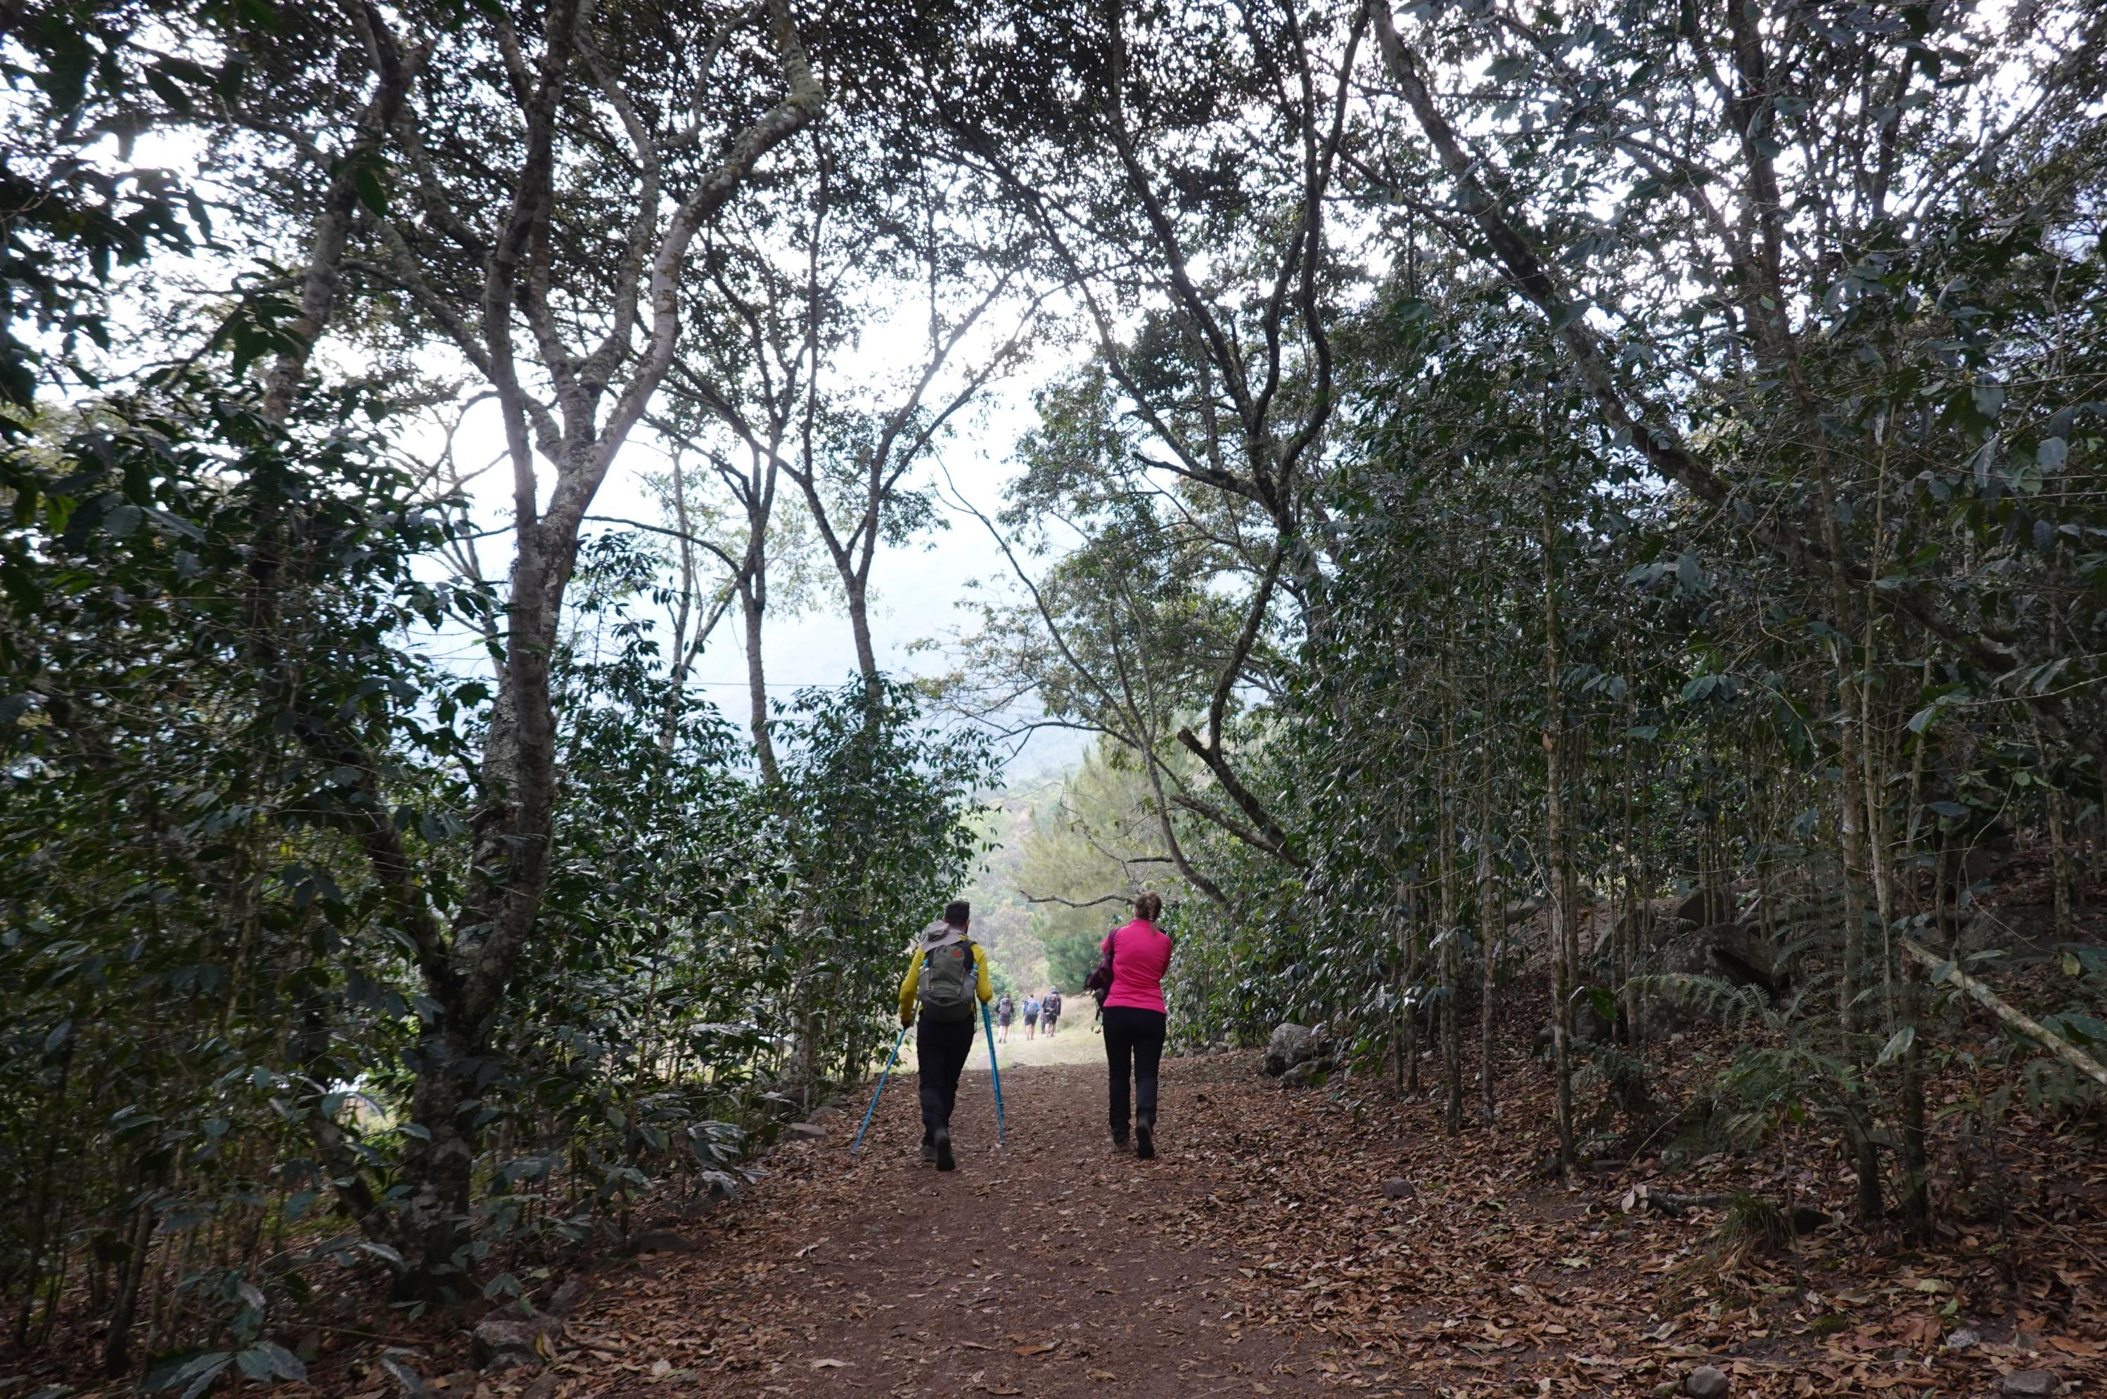
DAY 3: HIGHLIGHTS
WATERFALLS, RIVER CROSSINGS & LANDSLIDE AREAS

Slide 23
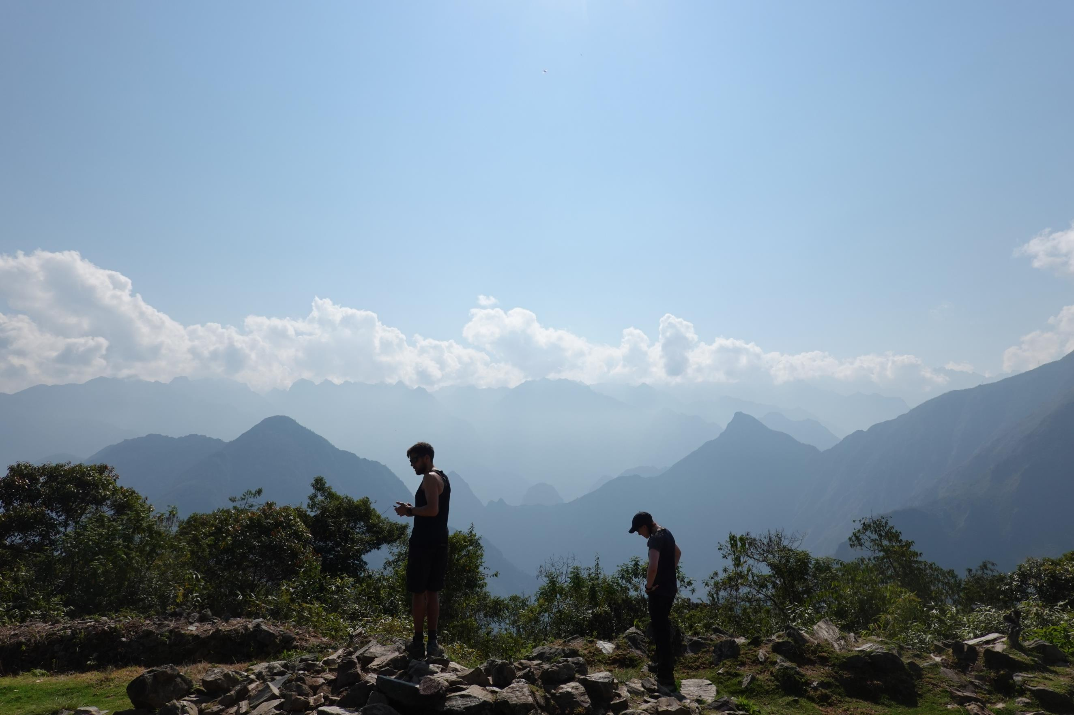
DAY 4:
LUCMABAMBA TO AGUAS CALIENTES
0630H
Depart Lucmabamba
0900H
Llactapata Ruins
1100H
Hidroelectrica
1500H
Aguas Calientes

Slide 24
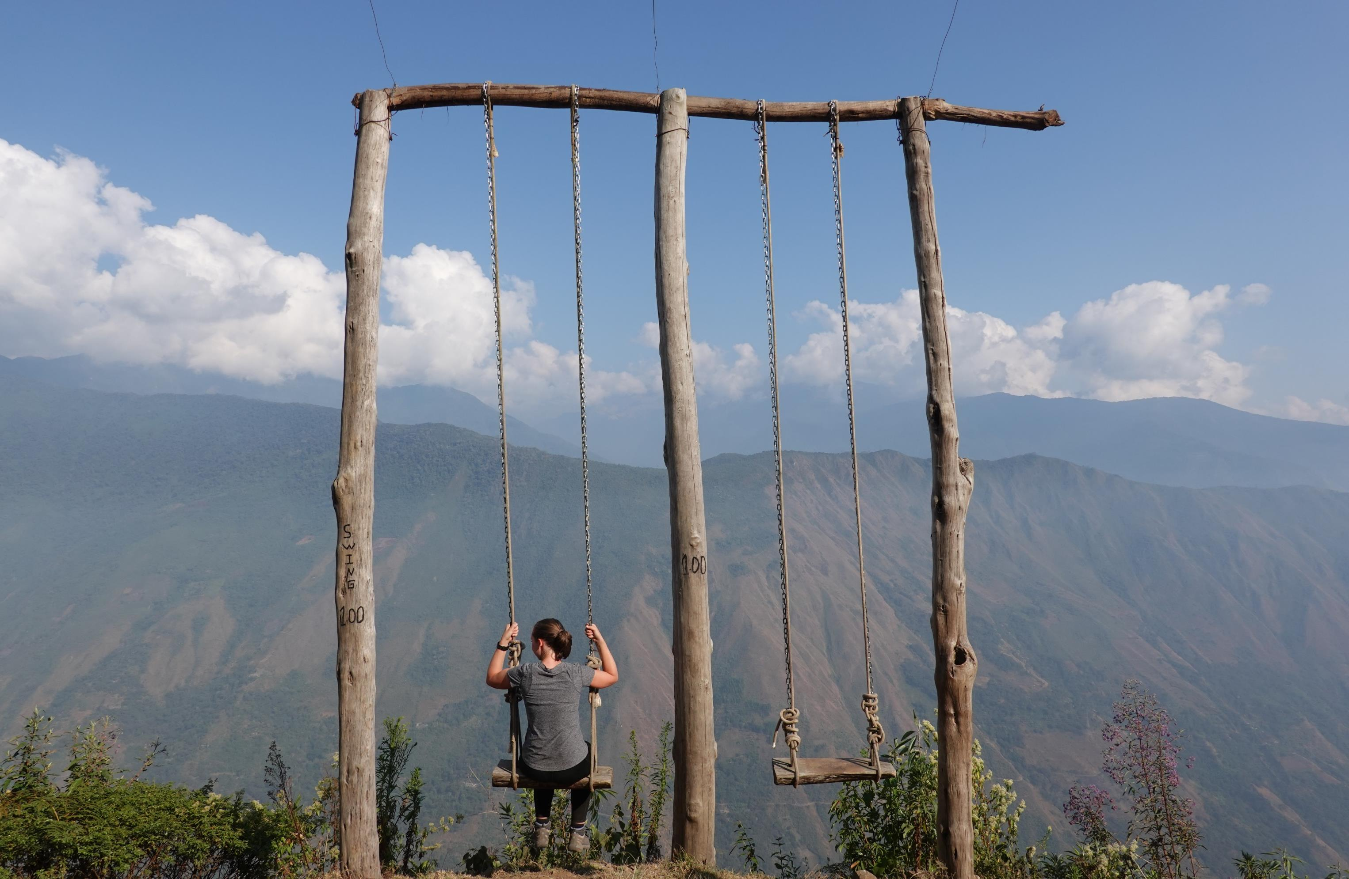
DAY 4: HIGHLIGHTS
21-KM STRETCH

Slide 25
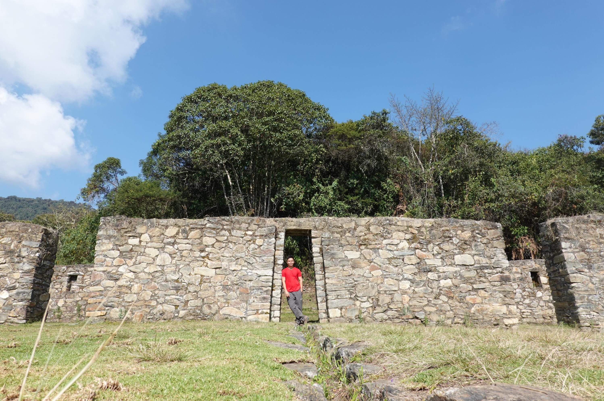
DAY 4: HIGHLIGHTS
6-KM ASSAULT TO LLACTAPATA RUINS

Slide 26
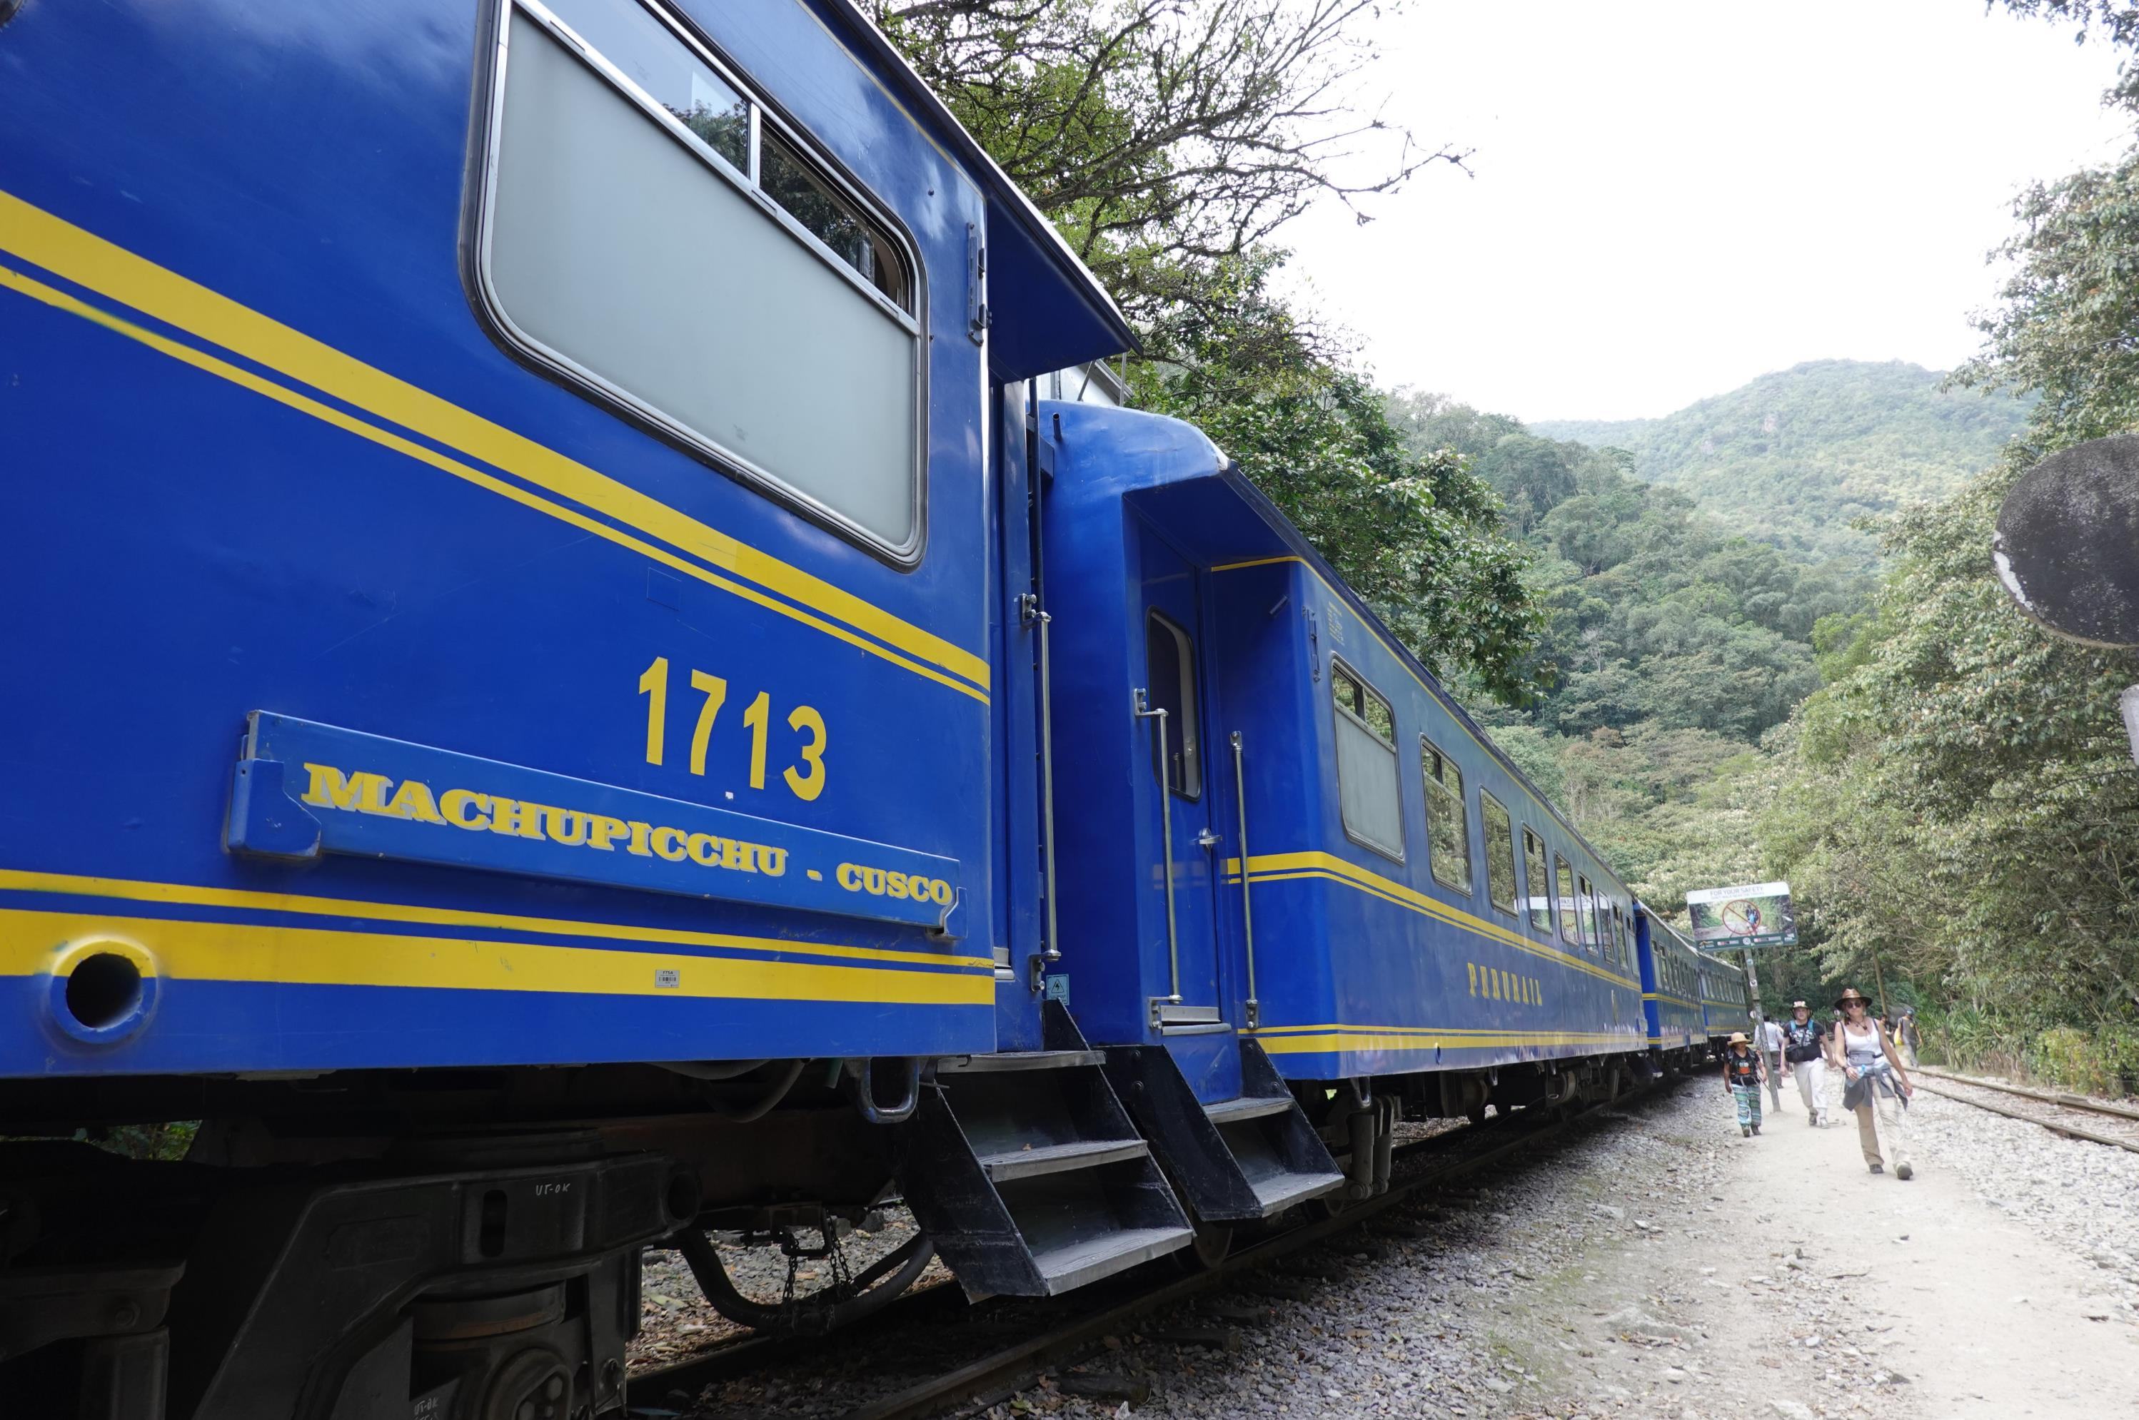
DAY 4: HIGHLIGHTS
HIDROELECTRICA

Slide 27
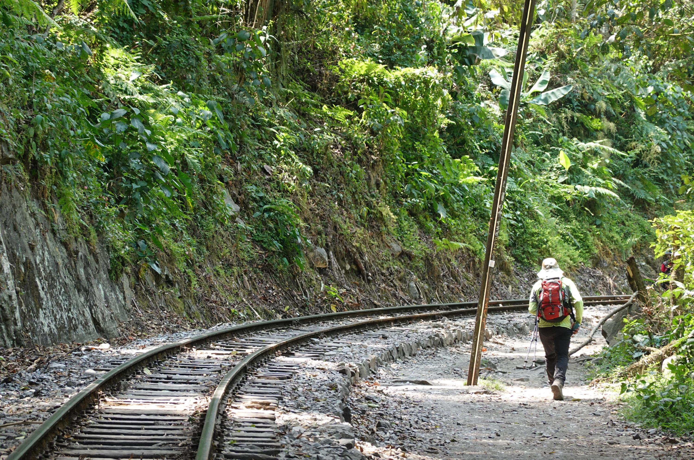
DAY 4: HIGHLIGHTS
11-KM WALK ALONG PERU RAIL TRACK

Slide 28
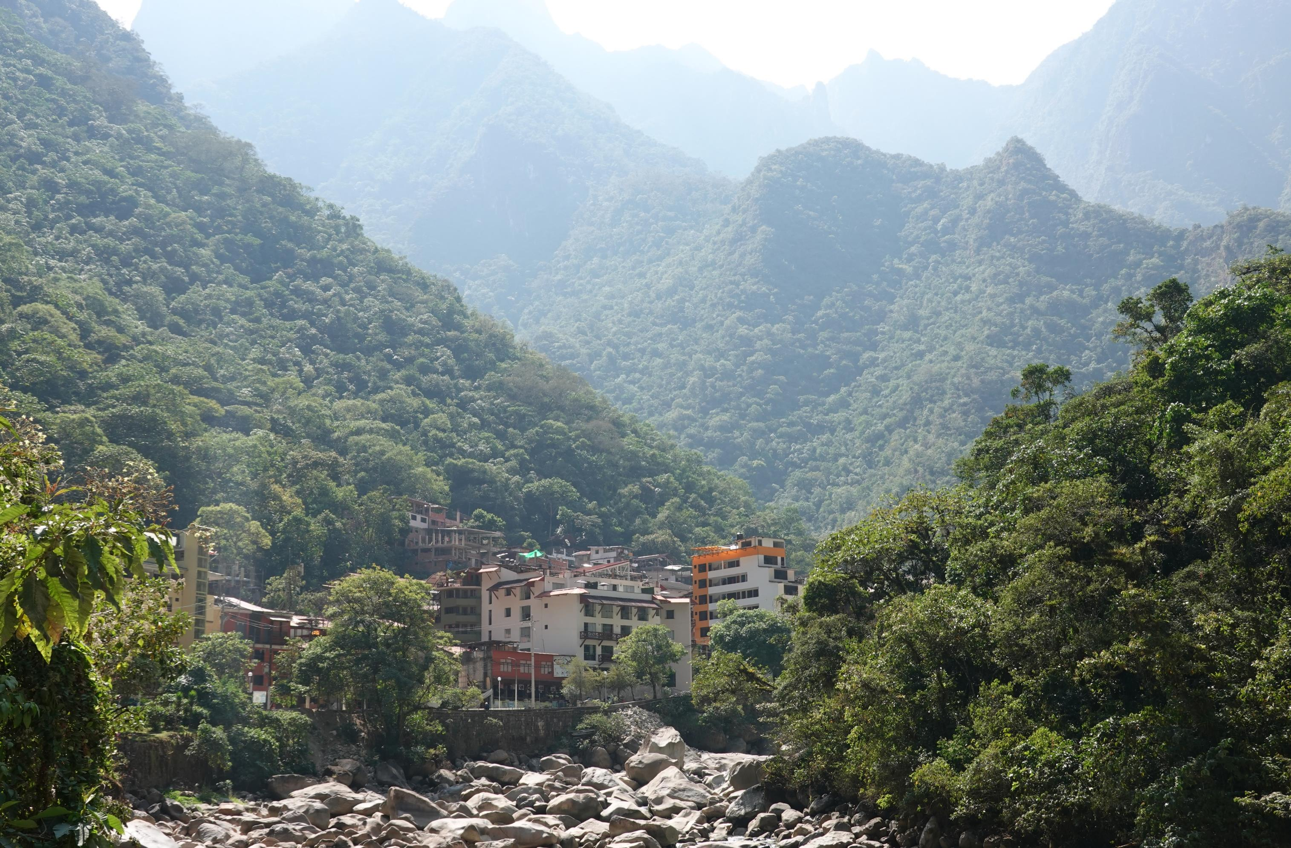
DAY 4: HIGHLIGHTS
AGUAS CALIENTES

Slide 29
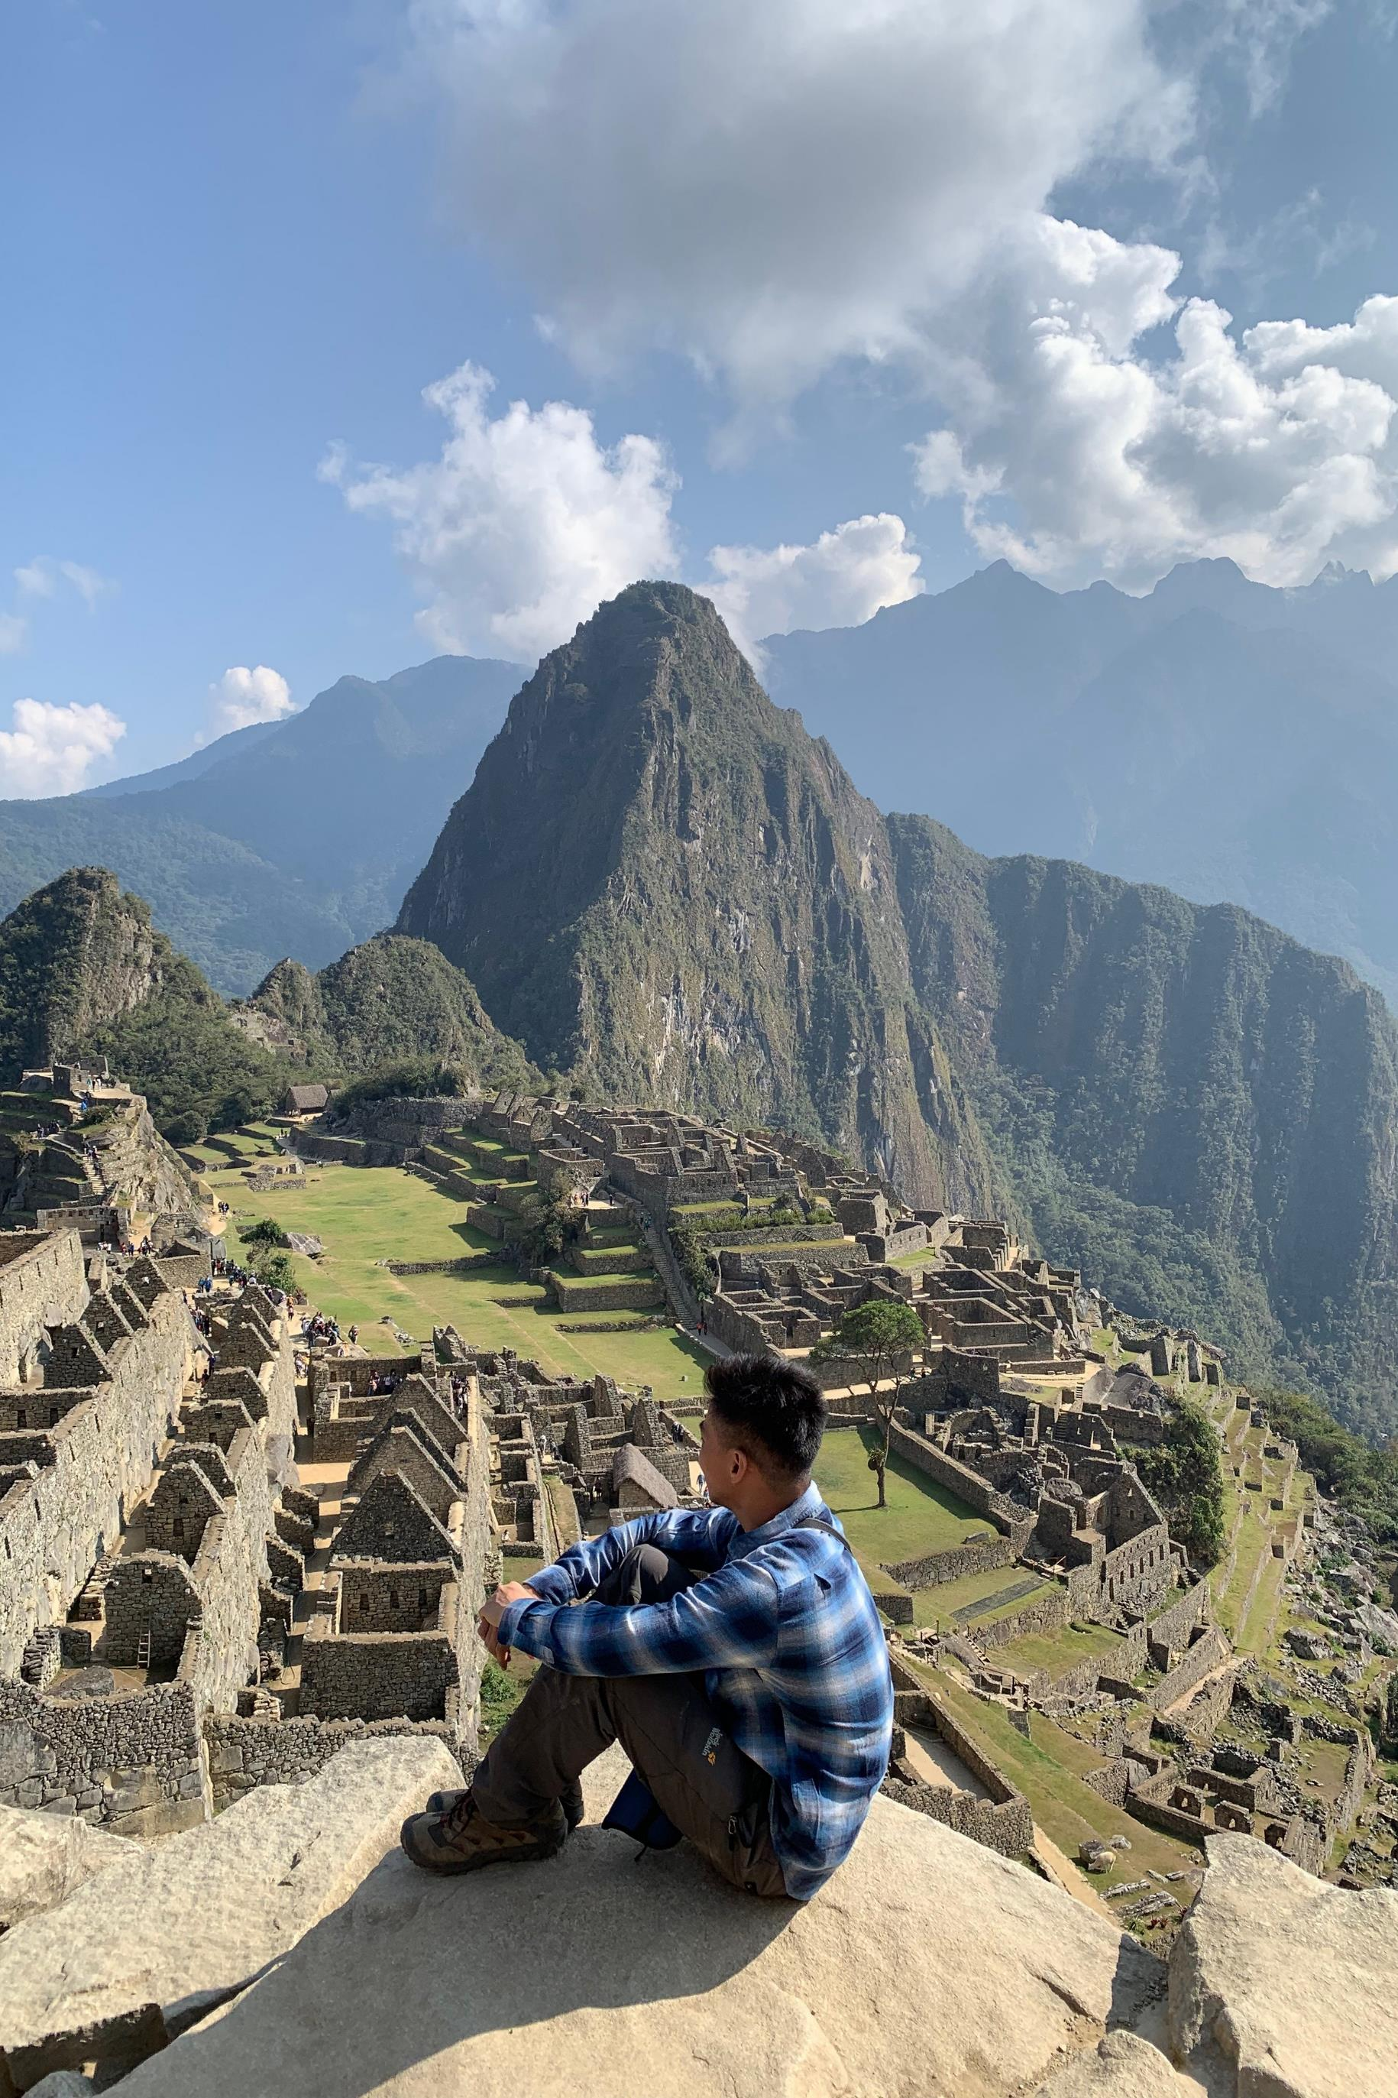
DAY 5:
MACHU PICCHU
& CUSCO
0730H
Depart Cusco
0845H
Arrive in Machu Picchu
1130H
Depart Aguas Calientes
1230H
Back in Hidroelectrica
1930H
Cusco

Slide 30
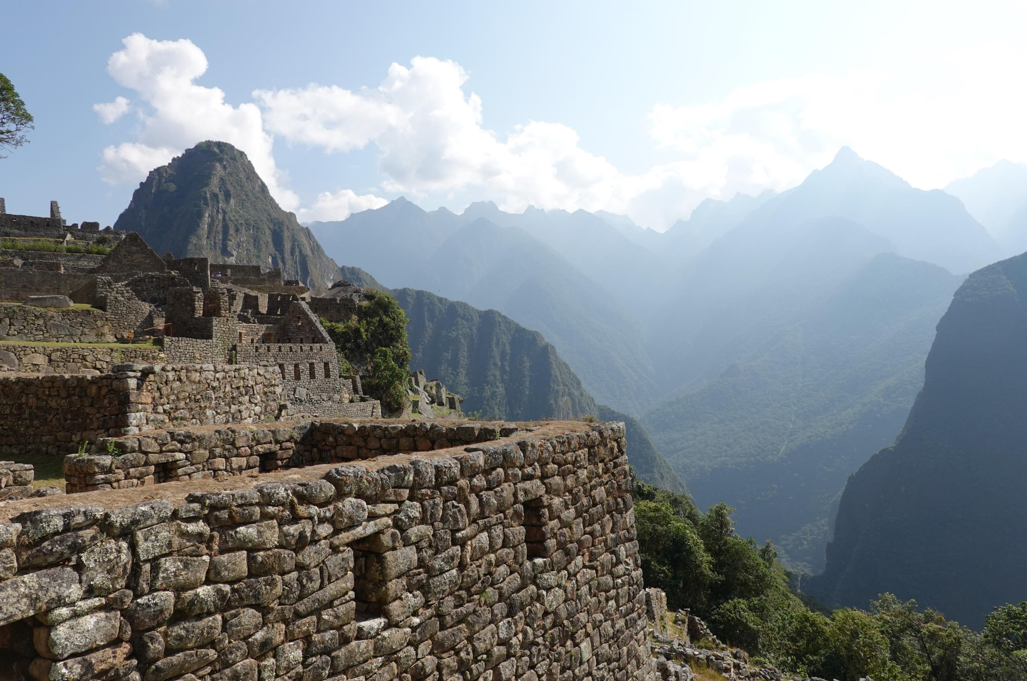
DAY 5: HIGHLIGHTS
MACHU PICCHU

Slide 31
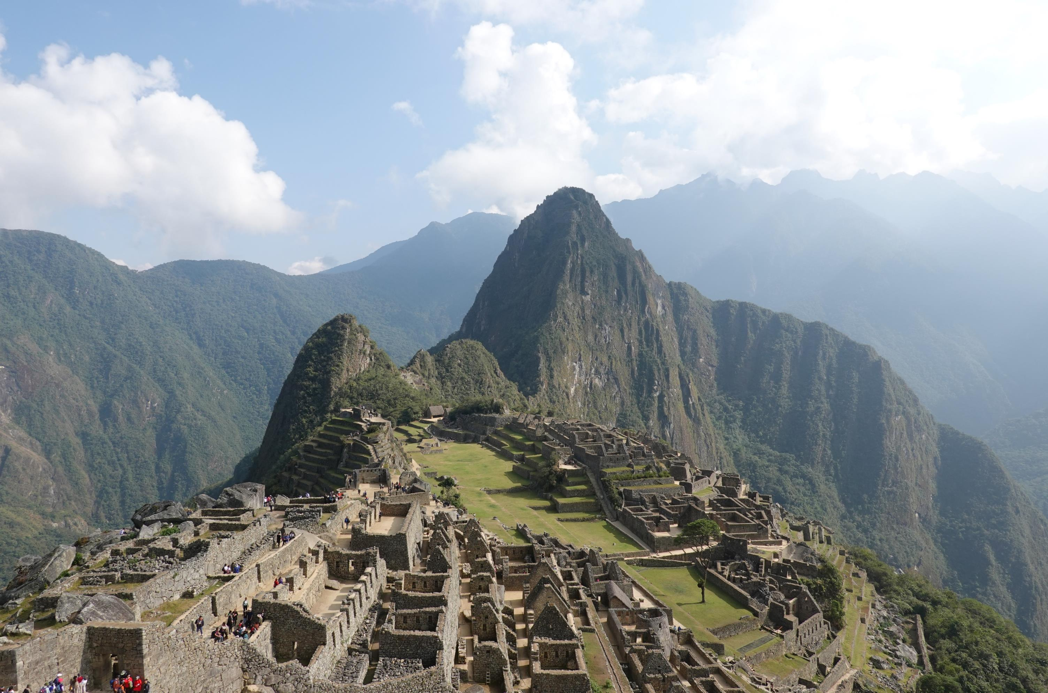
DAY 5: HIGHLIGHTS
MACHU PICCHU

Slide 32
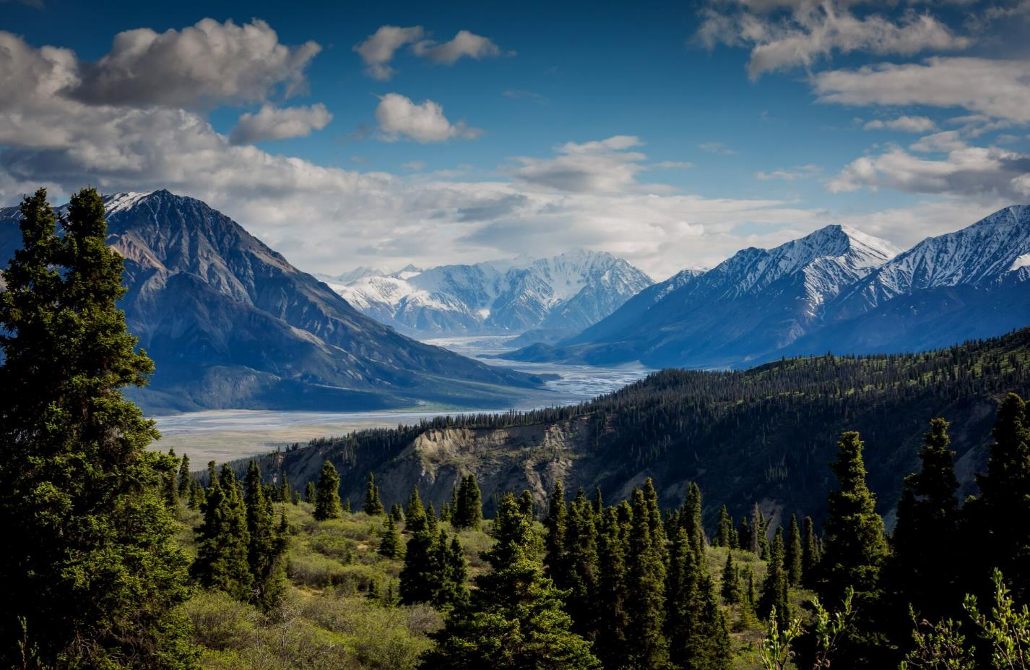
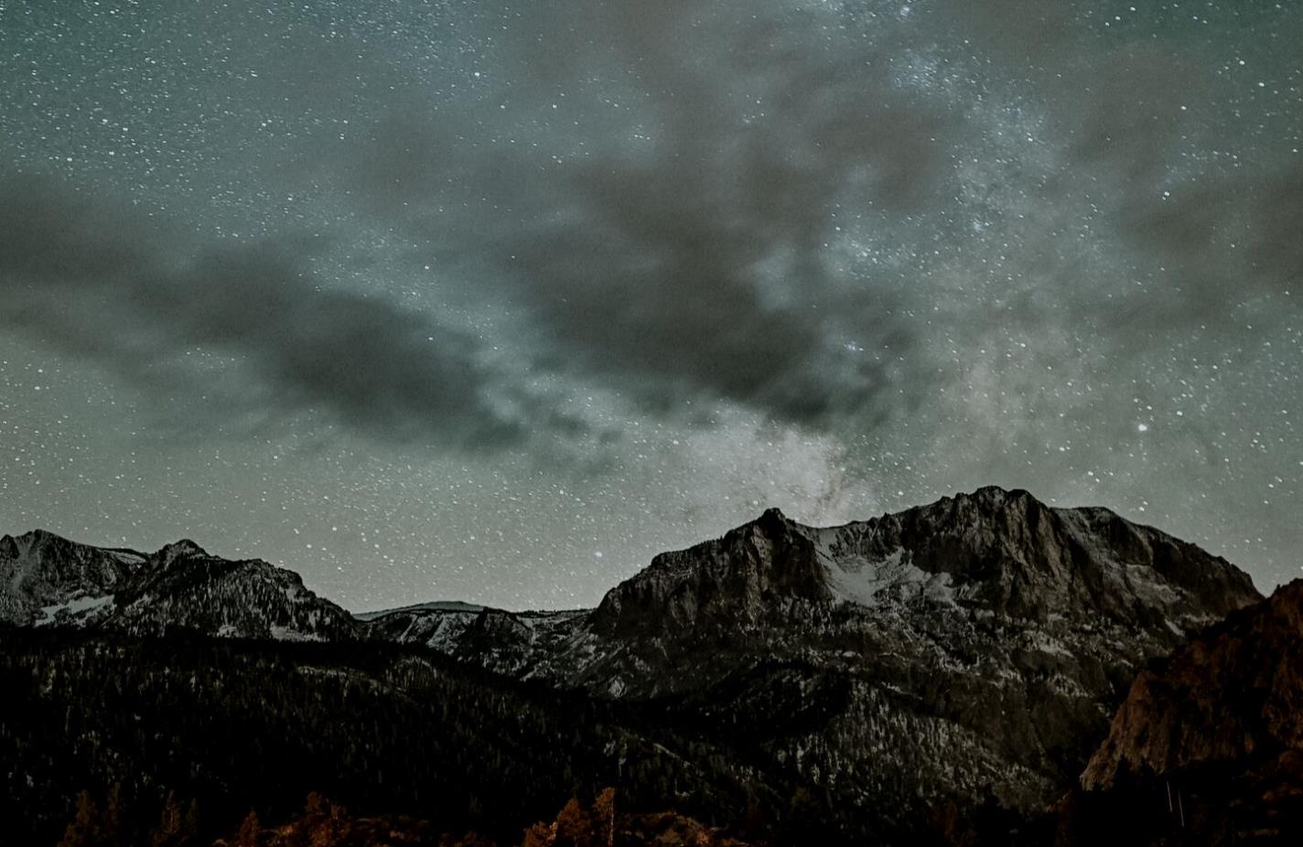
TIPS
BEST MONTHS
Presentations are communication tools that can be demonstrations, lectures, speeches, reports, and more.
GEAR RENTALS
Presentations are communication tools that can be demonstrations, lectures, speeches, reports, and more.

Slide 33
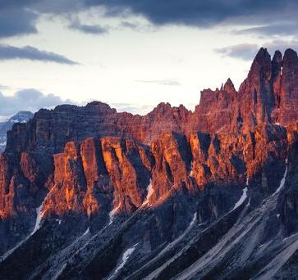
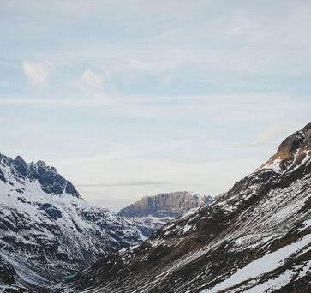
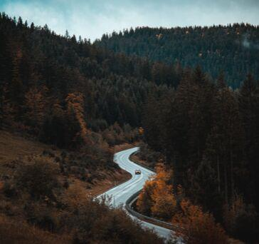
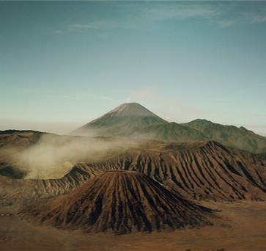
Vacations should be hassle-free.
Presentations are communication tools that can be demonstrations, lectures, speeches, reports, and more. Most of the time, they’re presented before an audience.

